Slide 1


Introduction to Software Business Product Management
Week 2 Day 3
Led by: Emily Crose
for
Oakland University

Slide 2
Day 2 Recap

Slide 3

Questions From Day 2?

Slide 4
Terms To Listen For
Application Programming Interface (API)
Enables automated, programmatic retrieval of information using a standard framework.
Authentication
Refers to the process of verifying a user’s identity.
Rate-Limit
How many requests can occur at a given time.

Slide 5
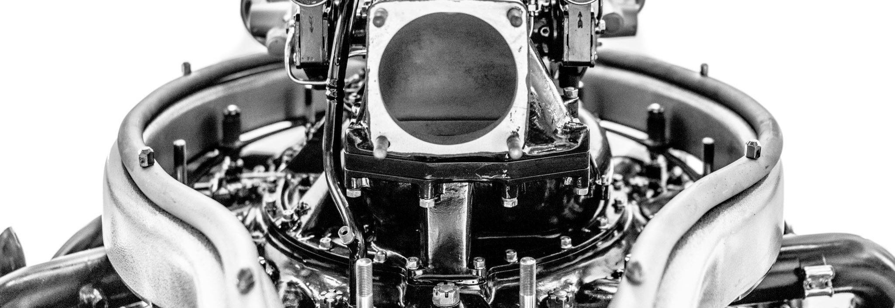

Purdue Model Explained

Slide 6
Purdue Mode, What Is It?
A method of arranging and segmenting networked operational technology (OT) devices.

Slide 7
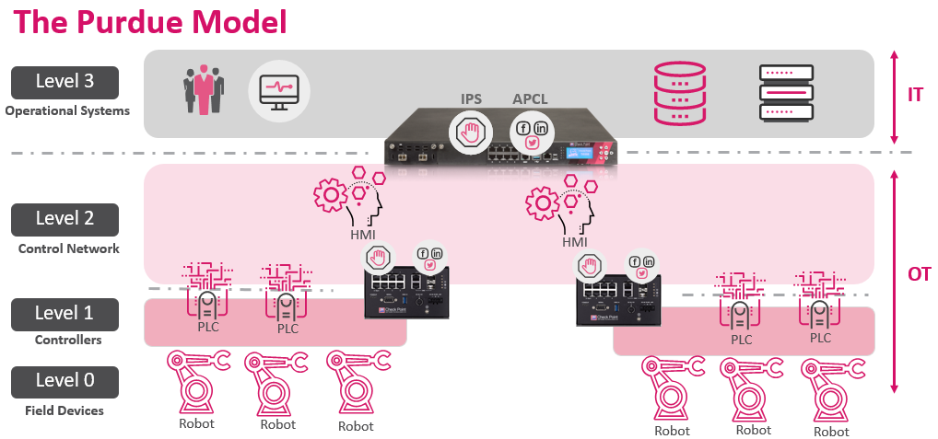

Slide 8
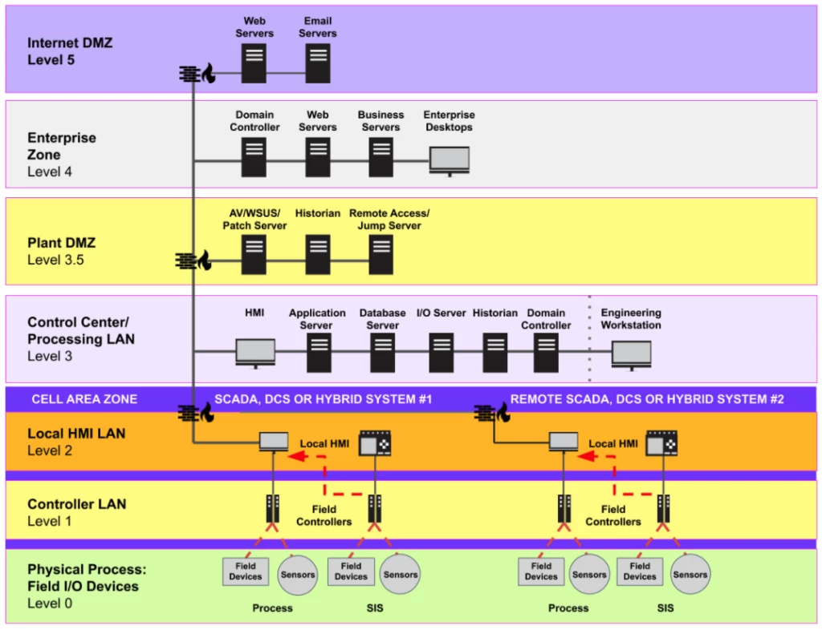

Slide 9
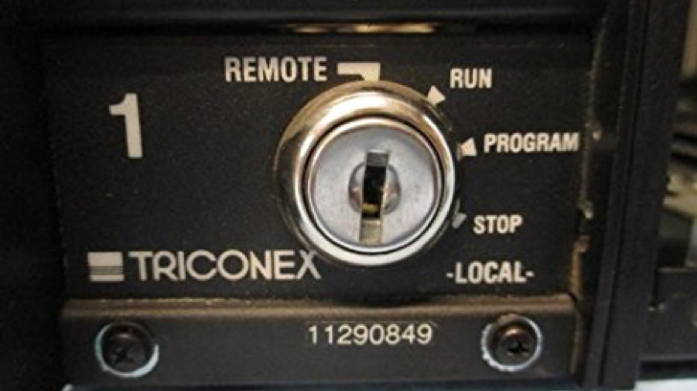
Anatomy Of A Complex OT Attack

Slide 10


Slide 11
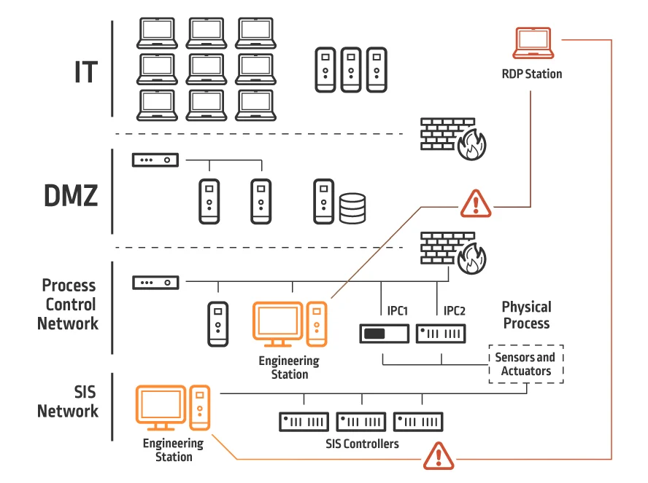
Inside The Victim Network

Slide 12
Who Cares About This?

Slide 13


Slide 14
How Does Software Fit In?

Slide 15

Can This Apply To Cars?

Slide 16
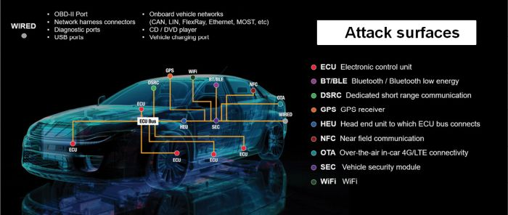
Car-Based Attack Surface

Slide 17
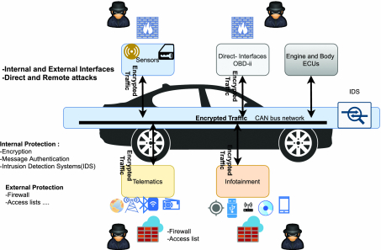
Local Car Network

Slide 18
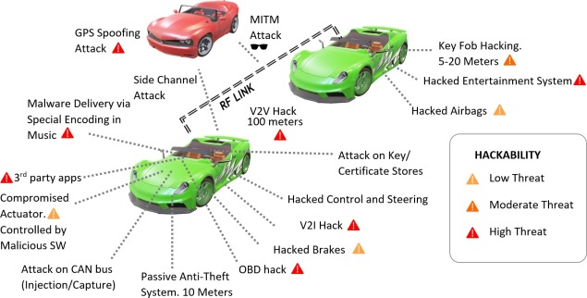
Popular Car Attack Surfaces

Slide 19
Application Programming Interfaces (APIs)
What do they do for applications?
How do they work?

Slide 20
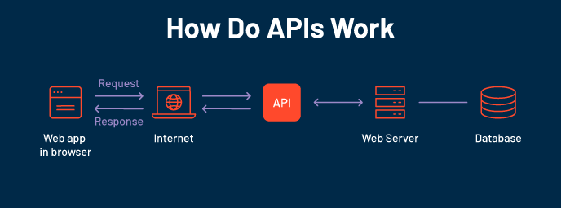

Slide 21
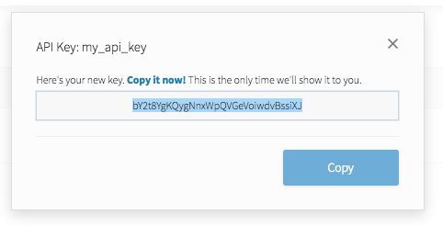
API Key
Notes:
API keys are meant to be kept secret. Why? Because they include information related to one specific account.

Slide 22

Why Do We Need API Keys?
Account verification
Who is requesting what information?
Rate limiting
Avoid denial of service
Permissions
What do we want to allow certain people to see?

Slide 23
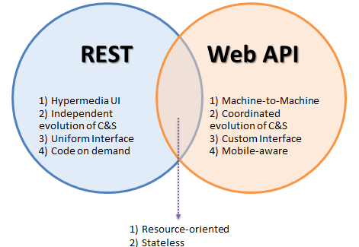
Popular API Frameworks

Slide 24
HTTP API Verbs
HTTP
GET
POST
PUT
DELETE

Slide 25
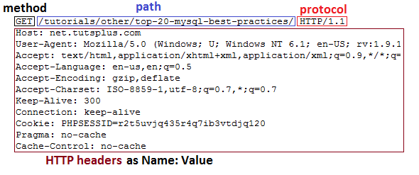
HTTP GET Header

Slide 26
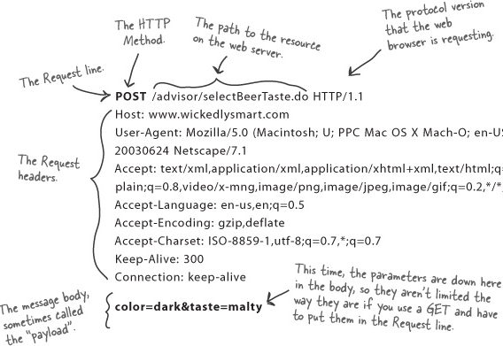
HTTP POST Header

Slide 27
Weather API
https://rapidapi.com/weatherapi/api/weatherapi-com

Slide 28
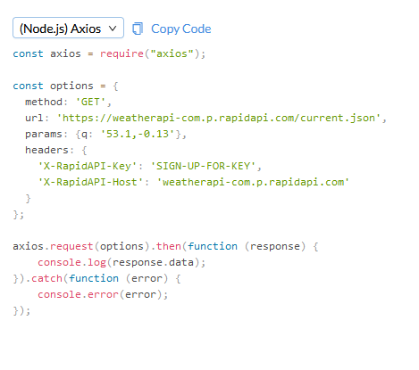
Notes:
So let’s take a look at what an API actually looks like in practice.

Slide 29

Securing APIs

Slide 30


What is Oauth?

Slide 31
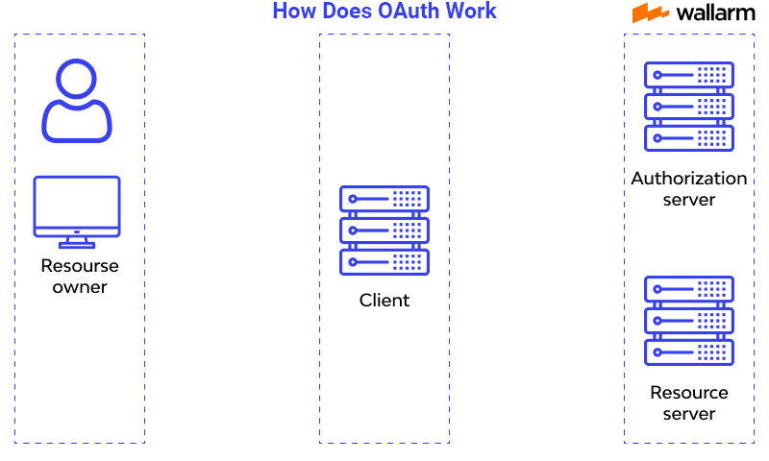
How does oauth work?

Slide 32
Let’s Make A Github Account!
https://github.com

Slide 33

Question or clarifications?

Slide 34

Questions?

Slide 35

Review Day 2

Slide 36

Preview day 3

